Slide 1
Encoder-Decoder Models
Jurafsky and Martin Chapter 10

Slide 2
Review: Recurrent Neural Networks (RNNs)
RNNs can be used for language modeling and sequence labeling. Transduction is the general process of taking in an input sequence and transforming it into output sequences in a one-to-one fashion.

Slide 3
Review: Recurrent Neural Networks (RNNs)
A recurrent neural network (RNN) is any network that contains a cycle within its network.
In such networks the value of a unit can be dependent on earlier outputs as an input.
RNNs have proven extremely effective when applied to NLP.
Notes:
The hidden layer includes a recurrent connection as part of its input. That is, the activation value of the hidden layer depends on the current input as well as the activation value of the hidden layer from the previous time step.
The figure illustrates the structure of a simple RNN. As with ordinary feedforward networks, an input vector representing the current input element, xt , is multiplied by a weight matrix and then passed through an activation function to compute an activation value for a layer of hidden units. This hidden layer is, in turn, used to calculate a corresponding output, yt . In a departure from our earlier window-based approach, sequences are processed by presenting one element at a time to the network. The key difference from a feedforward network lies in the recurrent link shown in the figure with the dashed line. This link augments the input to the computation at the hidden layer with the activation value of the hidden layer from the preceding point in time.

Slide 4
Review: Unrolled RNN
time
Notes:
A simple recurrent neural network shown unrolled in time. Network layers are copied for each time step, while the weights U , V and W are shared in common across all time steps.
The fact that the computation at time t requires the value of the hidden layer from time t − 1 mandates an incremental inference algorithm that proceeds from the start of the sequence to the end. The sequential nature of simple recurrent networks can also be seen by unrolling the network in time as is shown here.

Slide 5
Review: Recurrent Neural Language Models
Unlike n-gram LMs and feedforward networks with sliding windows, RNN LMs don’t use a fixed size context window.
They predict the next word in a sequence by using the current word and the previous hidden state as input.
The hidden state embodies information about all of the preceding words all the way back to the beginning of the sequence.
Thus they can potentially take more context into account than n-gram LMs and NN LMs that use a sliding window.

Slide 6
Generation with an RNN LM

Slide 7
Tag Sequences
Notes:
Part of speech tagging with a simple RNN

Slide 8
Sequence Classifiers
Notes:
Sequence classification using a simple RNN combined with a feedforward net- work. The final hidden state from the RNN is used as the input to a feedforward network that performs the classification.
Note that in this approach there are no intermediate outputs for the words in the sequence preceding the last element. Therefore, there are no loss terms associ- ated with those elements. Instead, the loss function used to train the weights in the network is based entirely on the final text classification task. Specifically, the out- put from the softmax output from the feedforward classifier together with a cross- entropy loss drives the training. The error signal from the classification is backprop- agated all the way through the weights in the feedforward classifier through, to its input, and then through to the three sets of weights in the RNN. This combination of a simple recurrent network with a feedforward classifier is our first example of a deep neural network. And the training regimen that uses the loss from a downstream application to adjust the weights all the way through the network is referred to as end-to-end training.

Slide 9
Stacked RNNs
Notes:
Stacked RNNs consist of multiple networks where the output of one layer serves as the input to a subsequent layer,
has been demonstrated across numerous tasks that stacked RNNs can outper- form single-layer networks. One reason for this success has to do with the network’s ability to induce representations at differing levels of abstraction across layers. Just as the early stages of the human visual system detect edges that are then used for finding larger regions and shapes, the initial layers of stacked networks can induce representations that serve as useful abstractions for further layers — representations that might prove difficult to induce in a single RNN.

Slide 10
Bidirectional RNNs

Slide 11
Bidirectional RNNs for sequence classification

Slide 12
Encoder-Decoder networks
Encoder-decoder networks are a kind of sequence-to-sequence model. Unlike vanilla RNNs, they can generate contextually appropriate, arbitrary length, output sequences.
They are useful for a wide range of NLP applications including:
Machine Translation
Automatic summarization
Question answering
Dialog modelling
Notes:
To understand encoder-decoder networks, let’s first look back at Autogregressive

Slide 13
Auto-Regressive Generation with an RNN LM
Notes:
To generate text:
first randomly sampling a word as the beginning of a sequence
then condition the generation of subsequent words on the hidden state from the previous time step and the word just generated
process continues until the end of sentence token <\s> is generated

Slide 14

Recall: autoregressive generation
$h_{t}=g\left(Uh_{t−1}+Wx_{t}\right), { y}_{t}=f(Vh_{t})$
$f$ is a softmax over the set of possible outputs

Slide 15
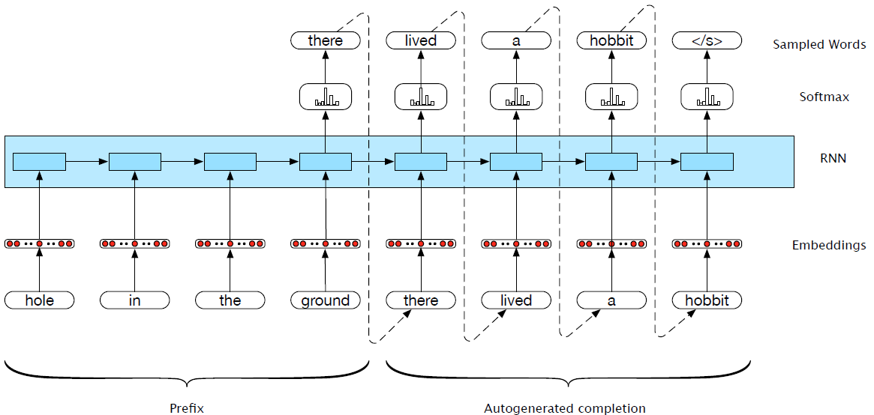
Generation with prefix
Notes:
What about generating from a specified prefix?
Now, let’s consider a simple variation on auto-regressive generation scheme. Instead of having the language model generate a sentence from scratch, we have it complete a sequence given a specified prefix. More specifically, we first pass the specified prefix through the language model using forward inference to produce a sequence of hidden states, ending with the hidden state corresponding to the last word of the prefix. We then begin generating as we did earlier, but using the final hidden state of the prefix as our starting point. The result of this process is a novel output sequence that should
be a reasonable completion of the prefix input.

Slide 16
Machine Translation (MT)
MT is the task of automatically translating sentences from one language into another.
We use bilingual parallel texts to train MT systems – pairs of source-target sentences that are translations of each other.
To extend LMs and autoregressive generation to MT, we will:
Add an end-of-sentence marker to each source sentence. Concatenate the target sentence to it.
Train an RNN LM based on this combined data.
To translate, simply treat the input sentence as a prefix, create a hidden state representation for it (encoding step).
Use the hidden state produced by the encoder to then start generating (decoding step)
Notes:
To translate a source text using the trained model, we run it through the network performing forward inference to generate hidden states until we get to the end of the source. Then we begin autoregressive generation, asking for a word in the context of the hidden layer from the end of the source input as well as the end-of-sentence marker. Subsequent words are conditioned on the previous hidden state and the embedding for the last word generated.

Slide 17
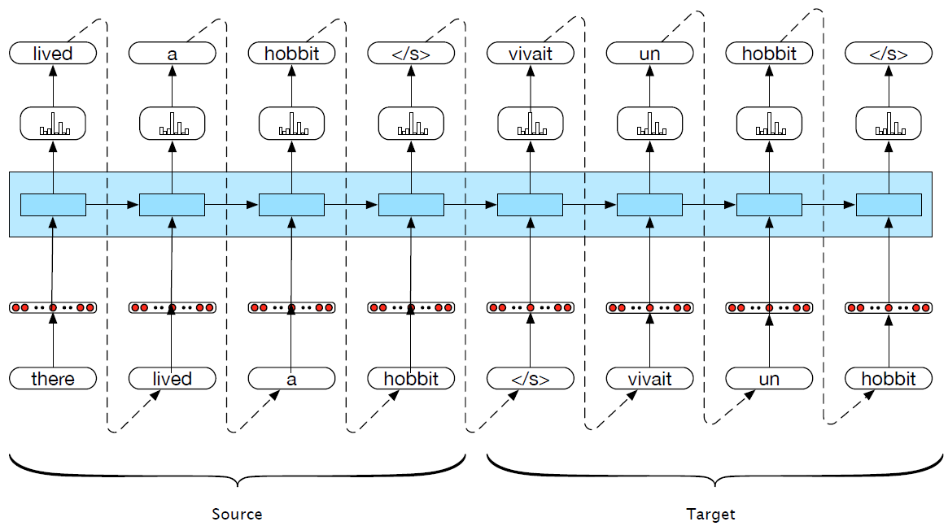
Machine translation

Slide 18
Encoder-Decoder Networks
We can abstract away from the task of MT to talk about the general encoder-decoder architecture:
An encoder takes an input sequence x^{n}_{1,} and generates a corresponding sequence of contextualized representations, h^{n}₁.
A context vector, c, is a function of h^{n}₁, and conveys the essence of the input to the decoder.
A decoder accepts c as input and generates an arbitrary length sequence of hidden states h^{m}₁ , from which can be used to create a corresponding sequence of output states y^{m}₁ .
Notes:
An encoder takes an input sequence x^{n}_{1,} and generates a corresponding sequence of contextualized representations, h^{n}₁.
A context vector, c, is a function of h^{n}₁, and conveys the essence of the input to the decoder.
A decoder accepts c as input and generates an arbitrary length sequence of hidden states h^{m}₁ , from which can be used to create a corresponding sequence of output states y^{m}₁ .

Slide 19
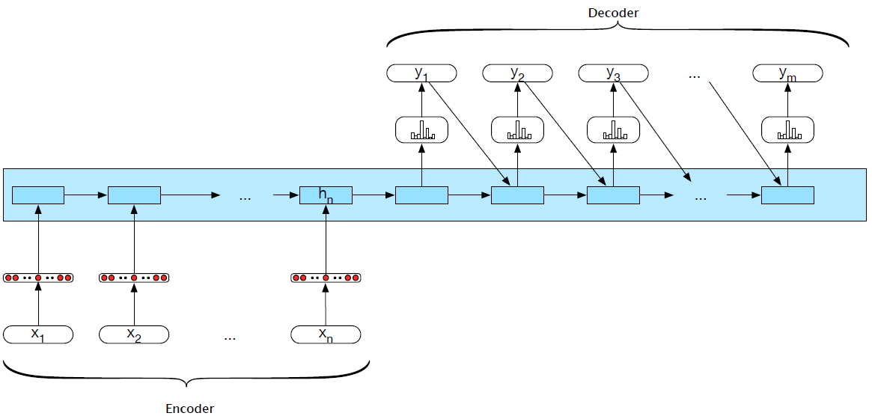
Encoder-decoder networks
Notes:
This basic architecture is consistent with the original applications of neural mod- els to machine translation. However, it embodies a number of design choices that are less than optimal. Among the major ones are that the encoder and the decoder are assumed to have the same internal structure (RNNs in this case), that the final state of the encoder is the only context available to the decoder, and finally that this context is only available to the decoder as its initial hidden state

Slide 20
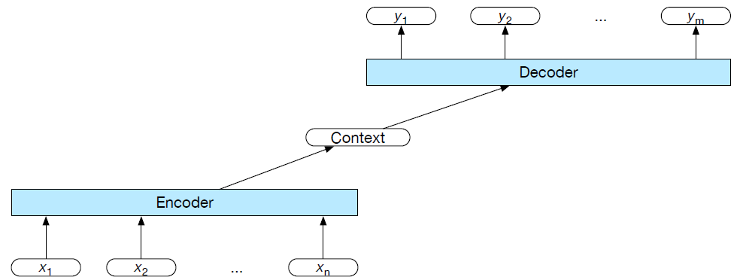
Encoder-decoder networks
An encoder that accepts an input sequence and generates a corresponding sequence of contextualized representations
A context vector that conveys the essence of the input to the decoder
A decoder, which accepts context vector as input and generates an arbitrary length sequence of hidden states, from which a corresponding sequence of output states can be obtained

Slide 21
Encoder
Pretty much any kind of RNN or its variants can be used as an encoder. Researchers have used simple RNNs, LSTMs, GRUs, or even convolutional networks.
A widely used encoder design makes use of stacked Bi-LSTMs where the hidden states from top layers from the forward and backward passes are concatenated

Slide 22
Stacked RNNs
Notes:
Stacked RNNs consist of multiple networks where the output of one layer serves as the input to a subsequent layer,
It has been demonstrated across numerous tasks that stacked RNNs can outper- form single-layer networks. One reason for this success has to do with the network’s ability to induce representations at differing levels of abstraction across layers. Just as the early stages of the human visual system detect edges that are then used for finding larger regions and shapes, the initial layers of stacked networks can induce representations that serve as useful abstractions for further layers — representations that might prove difficult to induce in a single RNN.

Slide 23
Bidirectional RNNs

Slide 24
Decoder
For the decoder, autoregressive generation is used to produce an output sequence, an element at a time, until an end-of-sequence marker is generated.
This incremental process is guided by the context provided by the encoder as well as any items generated for earlier states by the decoder.
Encoder
Decoder
Notes:
Recall, that g is a stand-in for some flavor of RNN and y_t−1 is the embedding for the output sampled from the softmax at the previous step

Slide 25
Decoder Weaknesses
In early encoder-decoder approaches, the context vector c was only directly available at the beginning of the generation process.
This meant that its influence became less-and-less imporant as the output sequence was generated.
One solution is to make c available at each step in the decoding process, when generating the hidden states in the deocoder
and while producing the generated output.
Notes:
adding it as a parameter to the computation of the current
Beam Search
A common approach to the calculation of the output layer y is to base it solely on this newly computed hidden state. While this cleanly separates the underlying recurrence from the output generation task, it makes it difficult to keep track of what has already been generated and what hasn’t. A alternative approach is to condition the output on both the newly generated hidden state, the output generated at the previous state, and the encoder context.
y =softmax(yˆ ,z,c) t t−1 t
Finally, as shown earlier, the output y at each time consists of a softmax computa- tion over the set of possible outputs (the vocabulary in the case of language models). What one does with this distribution is task-dependent, but it is critical since the re- currence depends on choosing a particular output, yˆ, from the softmax to condition the next step in decoding. We’ve already seen several of the possible options for this. For neural generation, where we are trying to generate novel outputs, we can sim- ply sample from the softmax distribution. However, for applications like MT where we’re looking for a specific output sequence, random sampling isn’t appropriate and would likely lead to some strange output. An alternative is to choose the most likely output at each time step by taking the argmax over the softmax output:
yˆ = argmaxP(yi|y<i)
This is easy to implement but as we’ve seen several times with sequence labeling, independently choosing the argmax over a sequence is not a reliable way of arriving at a good output since it doesn’t guarantee that the individual choices being made make sense together and combine into a coherent whole. With sequence labeling we addressed this with a CRF-layer over the output token types combined with a Viterbi- style dynamic programming search. Unfortunately, this approach is not viable here since the dynamic programming invariant doesn’t hold.
Beam Search
A viable alternative is to view the decoding problem as a heuristic state-space search and systematically explore the space of possible outputs. The key to such an ap- proach is controlling the exponential growth of the search space. To accomplish this, we’ll use a technique called beam search. Beam search operates by combin- ing a breadth-first-search strategy with a heuristic filter that scores each option and prunes the search space to stay within a fixed-size memory footprint, called the beam width.
At the first step of decoding, we select the B-best options from the softmax output y, where B is the size of the beam. Each option is scored with its corresponding probability from the softmax output of the decoder. These initial outputs constitute the search frontier. We’ll refer to the sequence of partial outputs generated along these search paths as hypotheses.
At subsequent steps, each hypothesis on the frontier is extended incrementally by being passed to distinct decoders, which again generate a softmax over the entire vocabulary. To provide the necessary inputs for the decoders, each hypothesis must include not only the words generated thus far but also the context vector, and the
hidden state.

Slide 26
Choosing the best output
For neural generation, where we are trying to generate novel outputs, we can simply sample from the softmax distribution.
In MT where we’re looking for a specific output sequence, sampling isn’t appropriate and would likely lead to some strange output.
Instead we choose the most likely output at each time step by taking the argmax over the softmax output

Slide 27
Beam search
In order to systematically explore the space of possible outputs for applications like MT, we need to control the exponential growth of the search space.
Beam search: combining a breadth-first-search strategy with a heuristic filter that scores each option and prunes the search space to stay within a fixed-size memory footprint, called the beam width

Slide 28
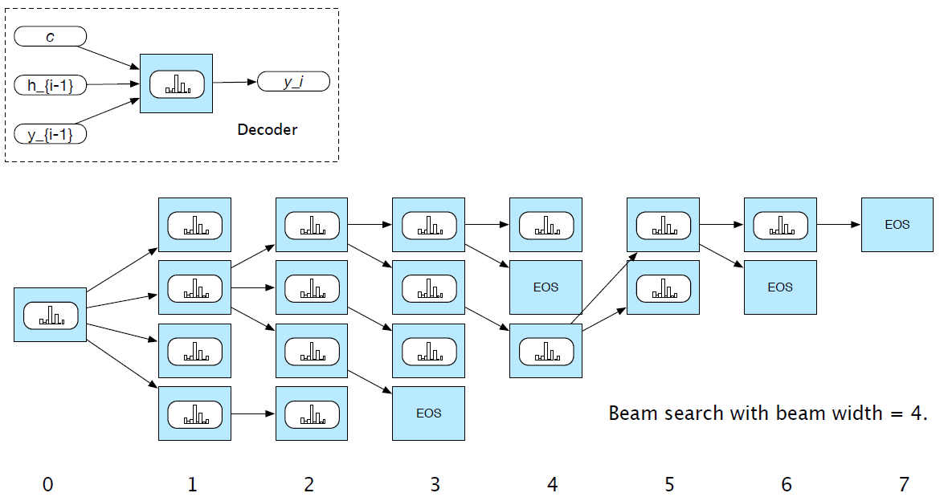
Beam search

Slide 29
Attention
Weaknesses of the context vector:
Only directly available at the beginning of the process and its influence will wane as the output sequence is generated
Context vector is a function (e.g. last, average, max, concatenation) of the hidden states of the encoder. This approach loses useful information about each of the individual encoder states
Potential solution: attention mechanism

Slide 30
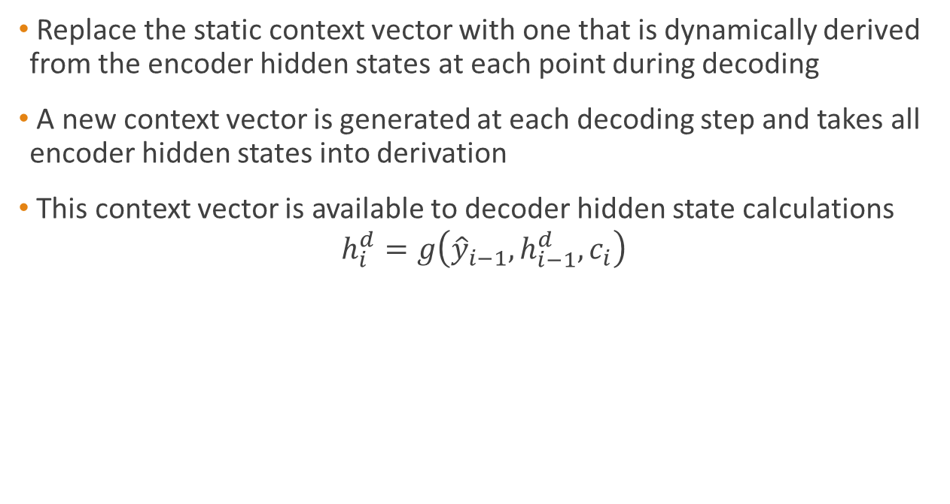
Attention
Replace the static context vector with one that is dynamically derived from the encoder hidden states at each point during decoding
A new context vector is generated at each decoding step and takes all encoder hidden states into derivation
This context vector is available to decoder hidden state calculations
$$h_{i}^{d}=g\left({\hat{y}}_{i−1},h_{i−1}^{d},c_{i}\right)$$

Slide 31

Attention
To calculate $c_{i}$, first find relevance of each encoder hidden state to the decoder state. Call it $score(h_{i−1}^{d},h_{j}^{e})$ for each encoder state $j$
The $score$ can simply be dot product,
Notes:
each encoder hidden state to the decoder state captured in hi−1.
h^d-1 = previous decoder state

Slide 32
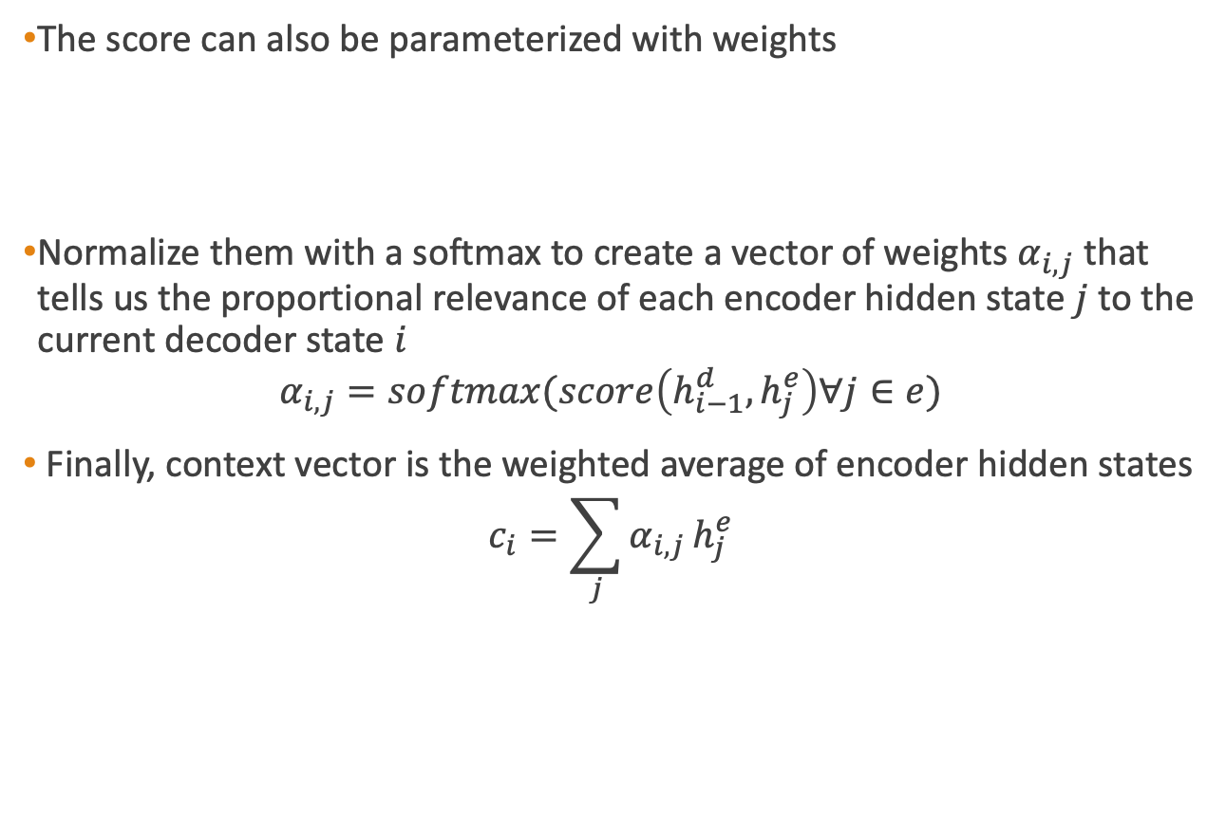
Attention
The score can also be parameterized with weights
Normalize them with a softmax to create a vector of weights $α_{i,j}$ that tells us the proportional relevance of each encoder hidden state $j$ to the current decoder state $i$
$$α_{i,j}=softmax(score\left(h_{i−1}^{d},h_{j}^{e}\right)∀j∈e)$$
Finally, context vector is the weighted average of encoder hidden states
$$c_{i}=\sum_{j}{α_{i,j}}h_{j}^{e}$$

Slide 33
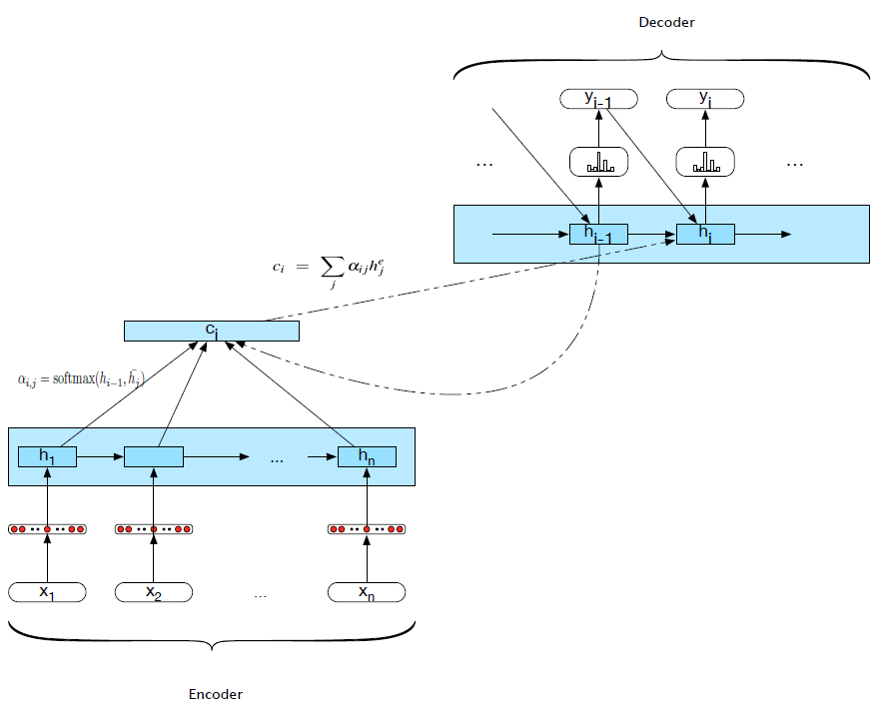
Attention mechanism

Slide 34
Applications of Encoder-Decoder Networks
Text summarization
Text simplification
Question answering
Image captioning
And more. What do those tasks have in common?

